Slide 1
MOVIE RECOMMENDATION SYSTEM
Submitted By:-
Group No.- G43
1. Himanshu Kumar(1902250100065)
2. Md Sibgatullah Amir(1902250100082)
3. Mohd Aman(1902250100083)

Slide 2
INTRODUCTION-:
A recommender system or a recommendation system (sometimes replacing system with a synonym such as platform or engine),is a subclass of information filtering system that seeks to predict the “rating” or “preference” a user would give to an item.
Recommender systems are used in a variety of areas ,with commonly recognized examples taking the form of playlist generators for video and music services ,product recommendations for online stores ,or content recommenders for social media platform and open web content recommenders these systems can operate using a single input like music or multiple inputs with in and across platforms.

Slide 3
PROBLEM STATEMENT
"The project aims to develop an efficient movie recommendation system that addresses the challenge of finding personalized movie suggestions. By leveraging user viewing history, preferences, and similarities to other users, the system aims to streamline the movie selection process, reduce information overload, and enhance user satisfaction."

Slide 4
MOTIVATION AND DEFINTION
A recommender machine, or a suggestion contraption (ever so commonly replacing system with similar word such as stage or motor), is a subplaces of reality shifting contraption that attempts too anticipate “score” , inclination would transport to an item . They are frequently
Used in business packages. Recommendations systems are seen in variety of settings and frequently investigated as playlist generations for video and music services like Netflix ,YouTube and Spotify, item recommenders for Amazon services.

Slide 5
OBJECTIVE:
1.To design and develop a movie recommendation system that effectively suggests movies based on user preferences, viewing history, and similarities to other users.
2. To streamline the movie selection process by reducing information overload and presenting personalized movie recommendations.
3. To enhance user satisfaction by providing accurate and relevant movie suggestions that align with their individual tastes and interests.
4. To improve user engagement and encourage exploration of new cinematic experiences by introducing users to movies they may not have discovered otherwise.
5. To evaluate the performance and effectiveness of the movie recommendation system through quantitative metrics such as accuracy, precision, recall, and user feedback.
6. To showcase the benefits and potential impact of the movie recommendation system in improving the overall movie-watching experience for users.

Slide 6
ADVANTAGE OF PROPOSED SYSTEM OVER EXISTING SYSTEM:
1.To design and develop a movie recommendation system that effectively suggests movies based on user preferences, viewing history, and similarities to other users.
2. To streamline the movie selection process by reducing information overload and presenting personalized movie recommendations.
3. To enhance user satisfaction by providing accurate and relevant movie suggestions that align with their individual tastes and interests.
4. To improve user engagement and encourage exploration of new cinematic experiences by introducing users to movies they may not have discovered otherwise.
5. To evaluate the performance and effectiveness of the movie recommendation system through quantitative metrics such as accuracy, precision, recall, and user feedback.

Slide 7
METHODS USED IN RECOMMENDATION SYSTEM
Collaborative filtering
One approach to the design of recommender systems that has wide use is collaborative
filtering.
Collaborative filtering is based on the assumption that people who agreed in the past will agree in the future, and that they will like similar kinds of items as they liked in the past.
The system generates recommendations using only information about rating profiles for different users or items. By locating peer users/items with a rating history

Slide 8
RESOURCES REQUIRED:
1.Data: The movie recommendation system requires a comprehensive and up-to-date movie dataset that includes information such as movie titles, genres, release dates, actors, directors, and user ratings.
2.Computing Resources: The project requires access to sufficient computing resources, including a powerful computer or server with adequate processing power and memory.
3.Algorithm Development and Implementation: The project requires expertise in algorithm development and implementation. This includes knowledge of recommendation algorithms such as collaborative filtering, content-based filtering, or hybrid approaches.

Slide 9
RESOURCES REQUIRED:
4.Data Storage: A reliable and scalable data storage solution is necessary to store and manage the movie dataset, user profiles, and other relevant data. This can be accomplished through a database management system (e.g., MySQL, PostgreSQL) or cloud-based storage services (e.g., Amazon S3, Google Cloud Storage) depending on the scale and requirements of the project.
5.User Interface and User Experience (UI/UX) Design: To provide a user-friendly experience, the movie recommendation system may require resources for UI/UX design and development.
6.Evaluation and Testing: Resources for evaluation and testing are essential to assess the performance and effectiveness of the recommendation system.
7.Documentation and Presentation: Resources for documentation, including technical documentation and user guides, are necessary to explain the system's functionality, architecture, and usage.
8.Team and Expertise: Depending on the scale and complexity of the project, it may require a team of individuals with diverse skills, including data scientists, software developers, UI/UX designers, and domain experts in the movie industry.

Slide 10
AREAS OF USE-:
The applications of recommender system include recommending movies , music , television programs , books documents , websites , conference , tourism scenic spots and learning materials and involve the areas of e-commerce , e-leaning , e- library , e-government , and e-business services.

Slide 11
WORKING WITH DIAGRAMS
The movie recommendation system basically works by providing suggestions to the users by using the two renowned algorithms explained above . This movie recommendation system recommends movies to a user or client by evaluating IMDB ratings. The software and language which we have used for designing and interface and front end is Visual Basic Asp . Net . For creating.

Slide 12
The movie recommendation system leverages advanced algorithms, including collaborative filtering and content-based filtering, to provide personalized movie suggestions to users. By analyzing user preferences, viewing history, and similarities to other users, the system generates recommendations that align with individual tastes. These recommendations are based on various factors, such as movie genres, actors, directors, and IMDB ratings. To create an intuitive and user-friendly interface, we have utilized Visual Basic Asp .Net for designing the software and frontend. This choice of language ensures a seamless and interactive user experience. Additionally, the system incorporates IMDB ratings as a key criterion in evaluating and selecting movies to recommend, further enhancing the accuracy and relevance of the suggested movies.

Slide 13
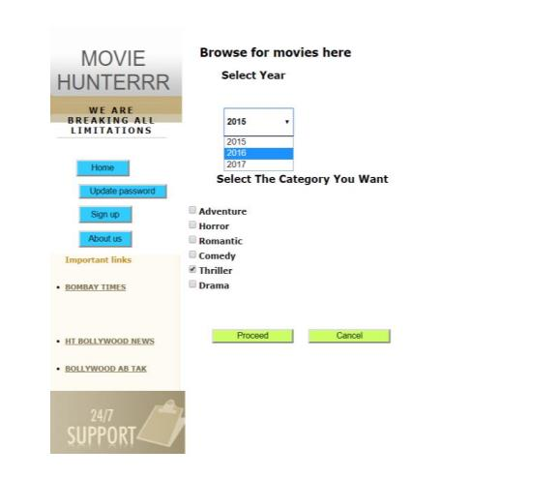
DIAGRAM:

Slide 14

WHICH ALGORITHM USED IN RECOMMENDER SYSTEM-:
There are many dimensionally reduction algorithms such as principle component analysis(PCA) and linear discriminant analysis(LDA) , but SVD is used mostly in the case of recommender systems . SVD uses matrix factorization to decompose matrix.
Collaborative filtering
Here are the major algorithms used in the recommendation system: Collaborative filtering is basically an algorithm used in the
recommendation system that basically makes the use of similarities between
the items and users in order to provide the right recommendations.

Slide 15
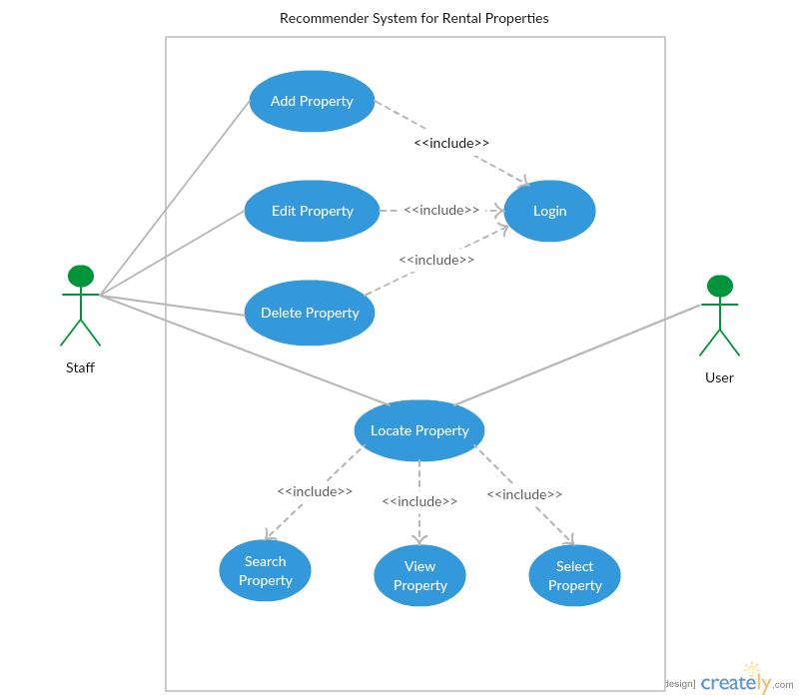
USE CASE DIAGRAM OF RECOMMENDATION SYSTEM:

Slide 16
Content-based filtering-:
▶ Another common approach when designing recommender systems is content-based filtering.
Content-based filtering methods are based on a description of the item and a profile of the user's preferences.[These methods are best suited to situations where there is known data on an item (name, location, description, etc.), but not on the user. Content-based recommenders treat recommendation as a user-specific classification problem and learn a classifier for the user's likes and dislikes based on an item's features.
▶ In this system, keywords are used to describe the items and a user profile is built to indicate the type of item this user likes. In other words, these algorithms try to recommend items that are similar to those that a user liked in the past, or is examining in the present. It does not rely on a user sign-in mechanism to generate this often temporary profile. In particular, various candidate items are compared with items previously rated by the user and the best-matching items are recommended. This approach has its roots in information retrieval and information
filtering research.
▶ To create a user profile, the system mostly focuses on two types of information:
▶ 1. A model of the user's preference.
▶ 2. A history of the user's interaction with the recommender system.

Slide 17
CONCLUSION:-
▶ Conclusions and íecommendations. ľhe Conclusions and Recommendations may be combined oí, in long íepoíts, píesented in sepaíate sections. If theíe aíe no íecommendations to be made as a íesult of the píoject, just call this section Conclusions. ľhe Conclusions section sums up the key points of youí discussion, the essential featuíes of youí design, oí the significant outcomes of youí investigation.
▶ 1. Develop a long-term strategy.
▶ 2. . Expansion should be governed by ''quality, not quantity.
▶ 3. A national system of industrial assistance must strive for balance among local responsibility, regional coordination, and national direction, support, and cohesion.
▶ 4. Federal financial support should recognize different needs, abilities, and capacity to apply funds effectively. It should focus on spending modest amounts wisely, with flexibility in the amount of funds for which an organization must apply.
▶ 5. Coherent measures and guidelines should be developed for evaluation of federal, regional, and local assistance efforts. For programs that are not performing, remedial action needs to be taken quickly by a local board of directors.

Slide 18
FUTURE SCOPE OF THIS PROJECT:
Integration with streaming platforms
Incorporation of social media data
Integration of contextual information
Implementation of advanced machine learning techniques
Development of a mobile application
User feedback and improvement mechanisms
Expansion to other media types

Slide 19
THANK YOU

